Slide 1
ELECTRICAL SCIENCE-1
(15B11EC111)
Unit-2
DC Circuit Analysis
Lecture-2
( Source Transformation)
Dr. Abhishek Kashyap
Assistant Professor (Senior Grade, JIIT Noida)

Slide 2
Topics to be Discussed
Source Transformation
Numerical
Practice Problems
References

Slide 3
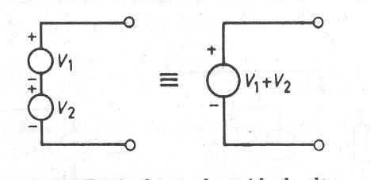
Ideal Voltage Sources Connected in Series

Slide 4
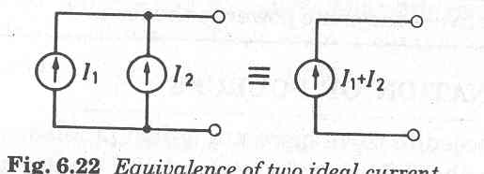
Ideal Current Sources Connected in Parallel

Slide 5
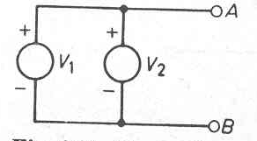
Ideal Voltage Sources Connected in Parallel
Such Connection is NOT permitted.

Slide 6
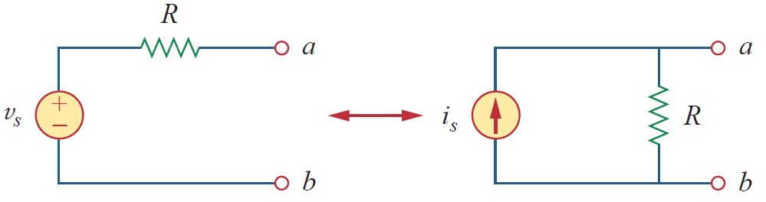
Source Transformation
Source transformation is another tool for simplifying circuits.
Basic to these tools is the concept of equivalence.
To be able to substitute a voltage source in series with a resistor for a current source in parallel with a resistor, or vice versa, as shown in Fig. Either substitution is known as a source transformation.
A source transformation is the process of replacing a voltage source v_{s} in series with a resistor R by a current source i_{s} in parallel with a resistor R, or vice versa.
Transformation of independent sources

Slide 7
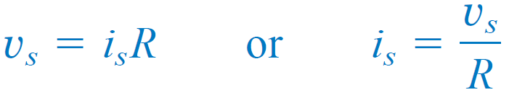
Source Transformation – Independent Sources
The two circuits in Fig. are equivalent—provided they have the same voltage-current relation at terminals a-b
Hence, source transformation requires that
Transformation of independent sources

Slide 8
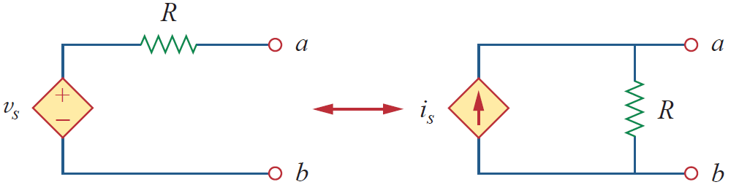
Source Transformation – Dependent Sources
Source transformation also applies to dependent sources, provided we carefully handle the dependent variable.
Transformation of dependent sources

Slide 9
Source Transformation
Source transformation does not affect the remaining part of the circuit.
When applicable, source transformation is a powerful tool that allows circuit manipulations to ease circuit analysis.
However, we should keep the following points in mind when dealing with source transformation.
the arrow of the current source is directed toward the positive terminal of the voltage source.
source transformation is not possible when R = 0, which is the case with an ideal voltage source. However, for a practical, non-ideal voltage source, R ≠ 0 .
Similarly, an ideal current source with R = ∞ cannot be replaced by a finite voltage source.

Slide 10
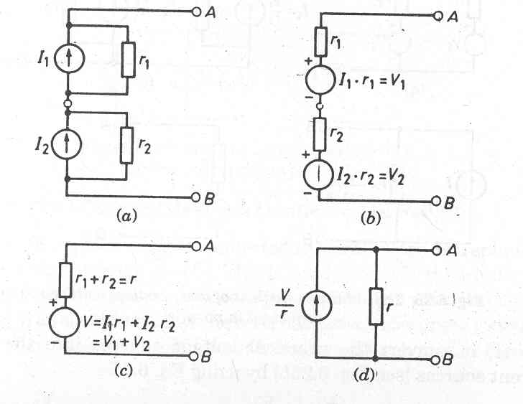
Practical Current Sources Connected in Series

Slide 11
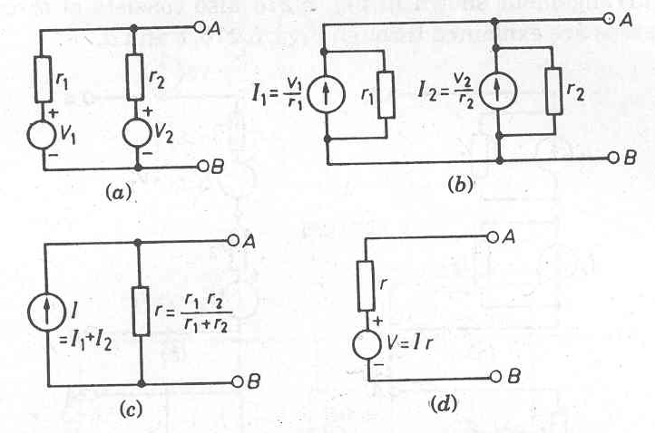
Practical Voltage Sources Connected in Parallel

Slide 12
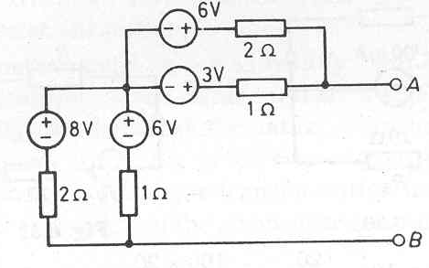
Problem
Reduce the network shown in figure to its simplest possible form by using source transformation.

Slide 13
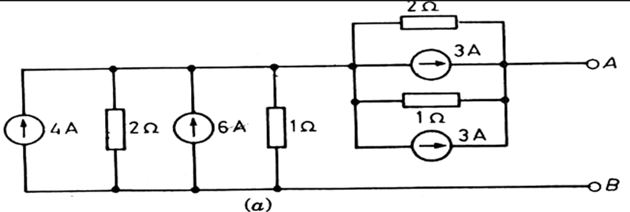
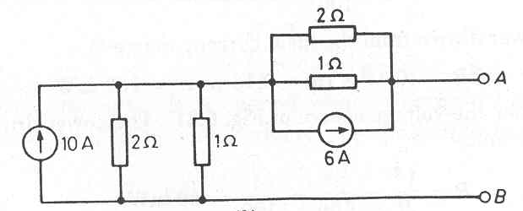
Problem - Solution

Slide 14
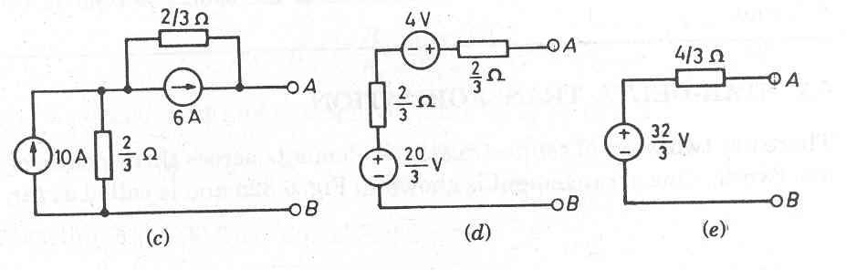
Problem - Solution

Slide 15
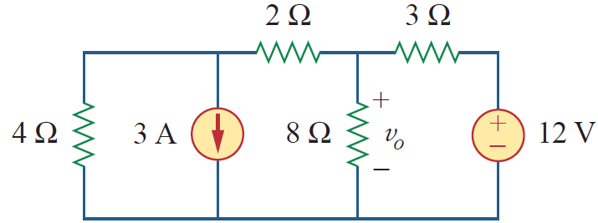
Problem
Use source transformation to find V₀ in the circuit of Fig.

Slide 16
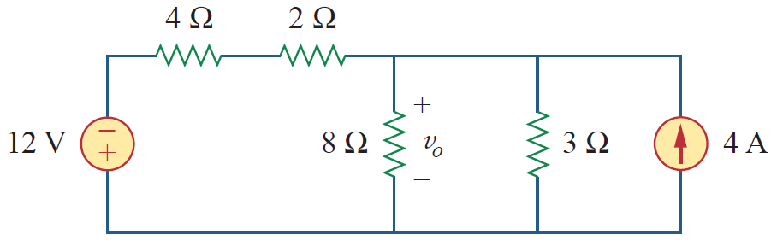
Problem - Solution
We first transform the current and voltage sources to obtain the circuit in Figure shown below

Slide 17
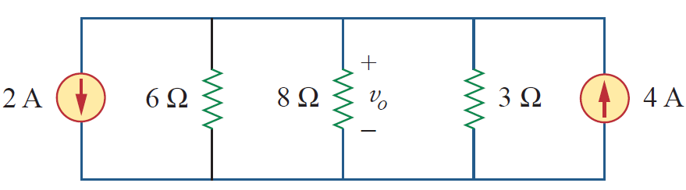
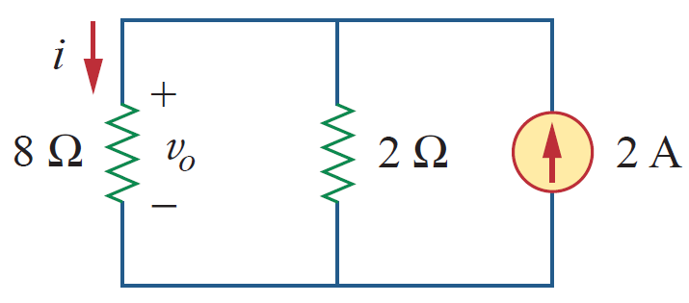
Problem - Solution
Combining the 4-Ω and 2-Ω resistors in series and transforming the 12-V voltage source gives us Figure shown below.
We now combine the 3-Ω and 6-Ω resistors in parallel to get 2-Ω. We also combine the 2-A and 4-A current sources to get a 2-A source. Thus, by repeatedly applying source transformations, we obtain the circuit shown in Figure.

Slide 18
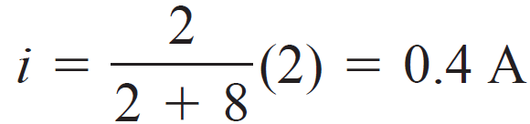
Problem - Solution
We use current division in Fig. to get
and

Slide 19
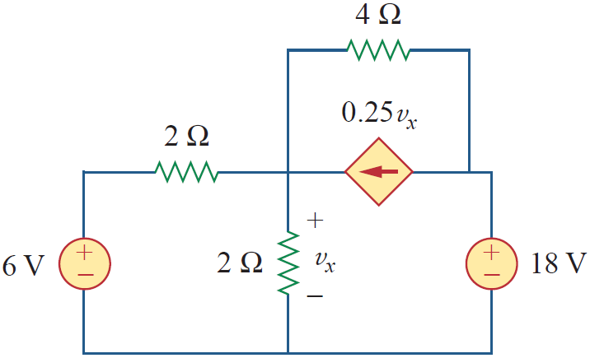
Practice Example
Find V_{x} in Fig. using source transformation

Slide 20
References
R.C. Dorf and James A. Svoboda, “Introduction to Electric Circuits”, 9th ed, John Wiley & Sons, 2013.
D.C. Kulshreshtha, Basic Electrical Engineering, Revised 1st ed, Tata Mc Graw Hill, 2017.
V. K.Mehta, Rohit Mehta, Basic Electrical Engineering, 6th ed, S. Chand Publishing, 2012.

